Slide 1

教育基金講座
Education Fund
BY
Lisa Hou, CLU ChFC
侯珞怡

Slide 2


Slide 3


Slide 4

他們一生下來 ，就要開始種一棵搖錢樹

Slide 5

Daddy
他們一生下來, 就要準備一部印鈔機

Slide 6

等他們要上大學時….

Slide 7

孩子, 爸爸已經幫你把錢準備好了!!
教育基金

Slide 8

天下父母心
明天可以去shopping 了!!
爸爸你真好!!

Slide 9

為什麼需要教育基金?
學費太貴, 存了安心
減稅優惠
學生償還貸款, 負擔沉重
傻唄!

Slide 10
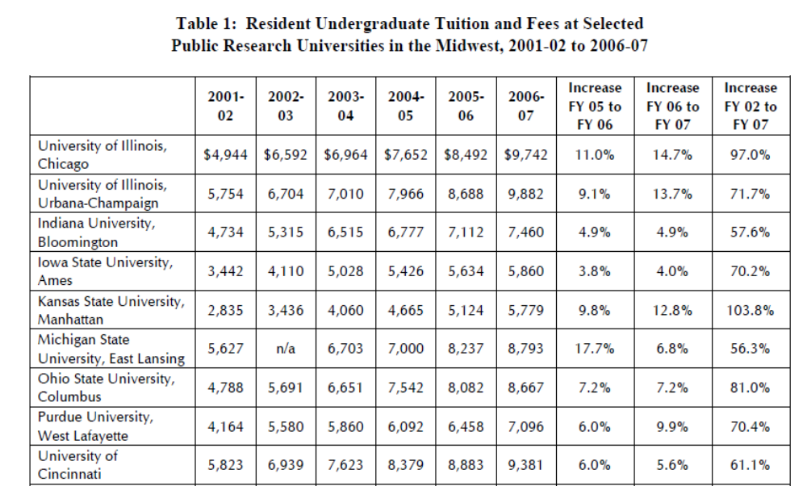

Slide 11
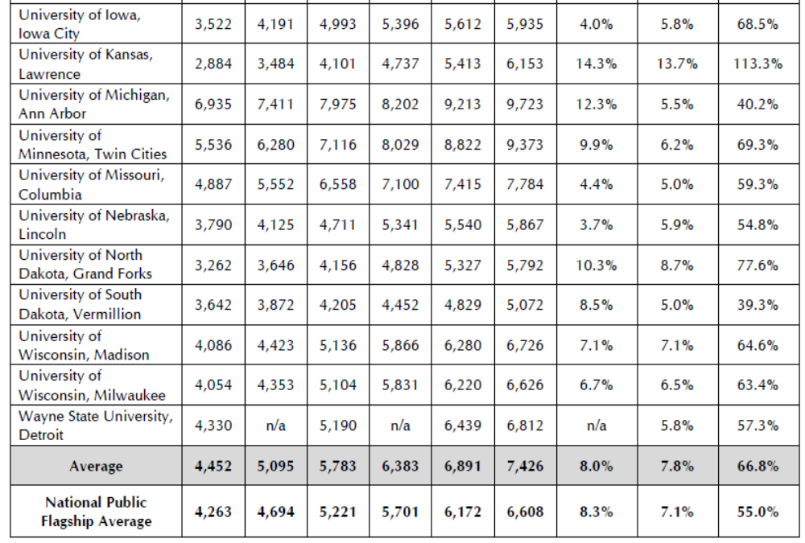

Slide 12
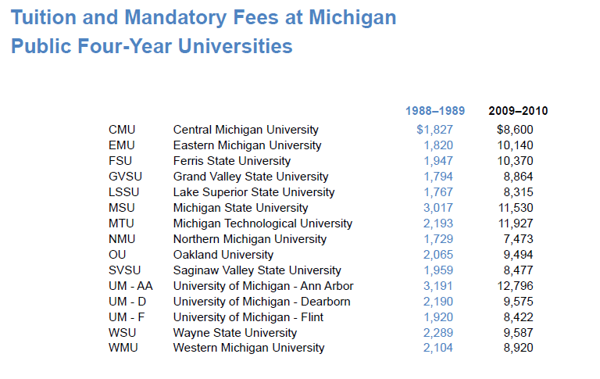

Slide 13
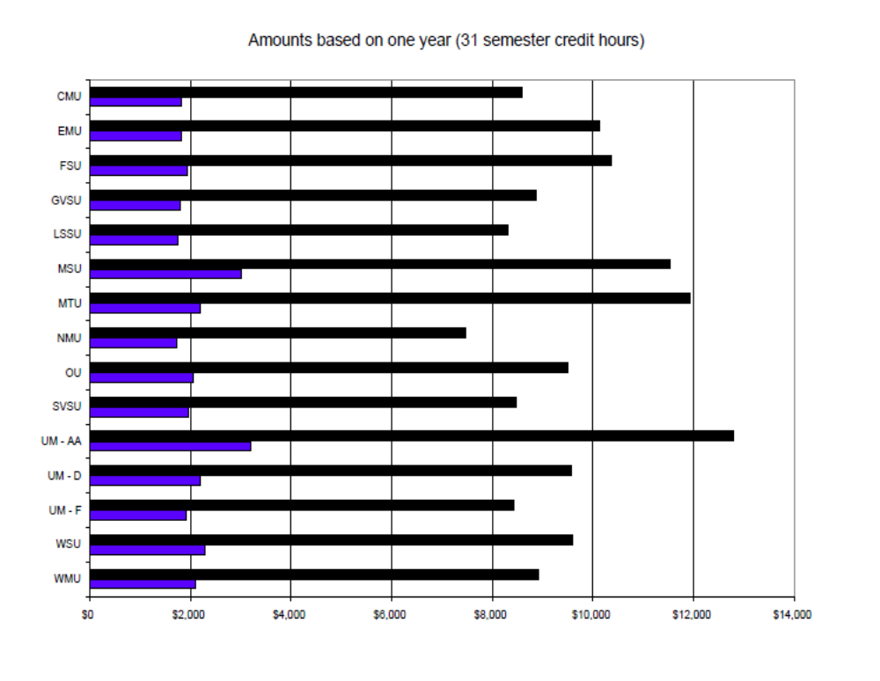

Slide 14
我需要準備多少錢?
Education fund Calculator
College Savings Planner

Slide 15
教育基金工具
529
  Michigan Education Trust (MET)
  MESP
UGMA
Coverdell Education Savings Account (ESA, used to be called Education IRA)
IRA, ROTH IRA
Life Insurance

Slide 16
什麼是529?
529 plan history
A 529 Plan is an education savings plan operated by a state or educational institution designed to help families set aside funds for future college costs. It is named after Section 529 of the Internal Revenue Code which created these types of savings plans in 1996

Slide 17
如何使用529?
State plans are OK for out of state colleges
529 Plans can be used to meet costs of qualified colleges nationwide. In most plans, your choice of school is not affected by the state your 529 savings plan is from. You can be a CA resident, invest in a VT plan and send your student to college in NC.
Savingforcollege.com - The internet guide to funding college and Section 529 college savings plans.

Slide 18
密西根州的529 Plan
Michigan Education Trust (MET)
Michigan Education Savings Program (MESP)

Slide 19
Michigan Education Trust
A Pre-paid Tuition plan
2010 Enrollment:
11/02/2009 -- 06/30/2010
Official Website
SET with MET - SET with MET

Slide 20
Michigan Education Trust
Three Plans:
The Full Benefits Plan provides full in-state tuition
and mandatory fees at any Michigan public
university, or tuition and mandatory fees at Michigan
public community colleges (in-district or
out-of-district) up to the number of credit hours
required for a standard four-year baccalaureate
degree (usually 120 semester credit hours).
Individuals may purchase in semester increments up

Slide 21
The Limited Benefits Plan
provides in-state tuition and mandatory fees at Michigan public universities, or tuition and mandatory fees at Michigan public community colleges (in-district or out-of-district) up to 105 percent of the weighted average tuition of all Michigan public four-year universities. If a student decides to attend a Michigan public college where tuition costs are higher than average, the number of credits allowed will be prorated based on the number
of credit hours MET can purchase with 105 percent
of the weighted average cost of Michigan public
four-year universities. This plan might not cover the
full cost of Michigan’s most expensive institutions.

Slide 22
The Community College Plan
provides in-district tuition and mandatory fees at Michigan public community colleges. Some areas of the State are not within a community college district. Students who attend a community college out of their district will be responsible to pay the difference between the out-of-district and in-district tuition cost.

Slide 23
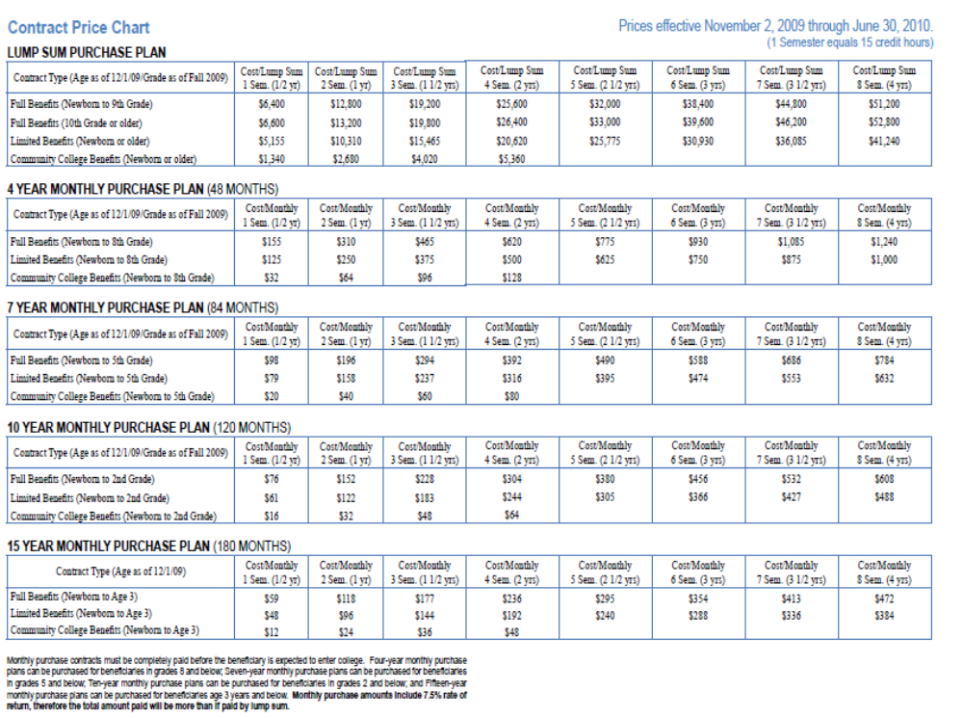

Slide 24
MET 優缺點
優點:
如果孩子將來就讀Michigan 學校, 穩賺不賠
State Income Tax Deduction (存錢省州稅)
A Purchaser may deduct the amount paid for a contract from taxable income when determining Michigan income tax for the year in which the contract is purchased.
Federal and State Income Tax (提錢省州稅, 聯邦稅)
MET is a qualified tuition program under Section 529 of the Internal Revenue Code. MET benefits used to pay college tuition and mandatory fees are exempt from federal and Michigan income taxes.

Slide 25
MET 優缺點
缺點
如果搬家或不唸密西根學校, 付費辦法不同
靈活性比較低

Slide 26
Michigan Education Savings Program (MESP)
Earnings Grow Federal and Michigan Income Tax-deferred
Any Earnings Used to Pay for Qualified Higher Education Expenses Are Federal and Michigan Income Tax Free
Michigan Income Tax Deduction
Federal Estate and Gift Tax Benefits
Managed by TIAA-CREF Individual & Institutional Services, LLC

Slide 27
MESP Investment options
Moderate Age-Based Allocation Option
Conservative Age-Based Allocation Option
Aggressive Age-Based Allocation Option, Balanced Option
100% Equity Option
100% Fixed Income Option
Principal Plus Interest Option

Slide 28
MESP Performance
http://www.misaves.com/pdf/performance.pdf

Slide 29
MESP 優缺點
優點
節稅的優點
比較靈活, 無論孩子到任何一州均可使用
缺點
投資風險

Slide 30
Coverdell Education Savings Account (ESA)
Maximum contribution per year is $2000
The account must be fully withdrawn by the time the beneficiary reaches age 30, or else it will be subject to tax and penalties.
Works like Roth IRA, except it is an investment vehicle targeted to education expenses.

Slide 31
IRA, Roth IRA
雖然是退休工具, 也可用來付學費
Penalty free early distributions can be made to pay for qualified expenses in relation to higher education fees, applicable not only to the IRA owner but also certain family members
Income limits and contribution limits
Possible of $6000/yr.

Slide 32
Uniform gift to Minor Account
(UGMA)
is simply a way for a minor to own property, such as securities.
You use the minor's social security number as the taxpayer ID for this account.
Tax advantage

Slide 33
Tax Advantage of UGMA
With a minor child:
  First $900 of unearned income → No tax
  Next $900 of Unearned income → At Child’s tax bracket: 15%
  Any additional amount will be taxed at Parent’s top income tax bracket
If the child is 19 and not a student, or 24, regardless of student status, the parent's tax situation does not come into play at all. All the income is on the child's return and he or she is taxed as an entity unto himself/herself.

Slide 34
如果我不在了, 我的孩子還要唸大學嗎?

Slide 35
人壽保險
一般人應該有 5-7 倍年薪的保額
保險種類:
Term Insurance
Universal Insurance

Slide 36
謝謝參加
詢問電話: 248-788-7934
lisayhou@comcast.net

